Slide 1
Collaborating with Tribal Communities: A Webinar Series
Webinar 3: A Trauma-Informed Approach to Working with Tribes
March 21, 2023
Terrance Lafromboise, MSW-ITR
Dolores Subia BigFoot, PhD

Slide 2


Funding and Disclaimer
The Suicide Prevention Resource Center at the University of Oklahoma Health Sciences Center is supported by a grant from the U.S. Department of Health and Human Services (HHS), Substance Abuse and Mental Health Services Administration (SAMHSA), Center for Mental Health Services (CMHS), under Grant No. 1H79SM083028-01.
The views, opinions, and content expressed in this product do not necessarily reflect the views, opinions, or policies of CMHS, SAMHSA, or HHS.

Slide 3
About SPRC
The Suicide Prevention Resource Center (SPRC) is the only federally funded resource center devoted to advancing the implementation of the National Strategy for Suicide Prevention. SPRC is supported through a grant from the U.S. Department of Health and Human Services' Substance Abuse and Mental Health Services Administration (SAMHSA).
SPRC builds capacity and infrastructure for effective suicide prevention through consultation, training, and resources for state, tribal, health/behavioral health, and community systems; professionals and professional education programs; and national public and private partners.

Slide 4
Land Acknowledgement
We acknowledge that the land that now makes up the United States of America was the traditional home, hunting ground, trade exchange point, and migration route of more than 574 American Indian and Alaska Native federally recognized tribes and many more tribal nations that are not federally recognized or no longer exist.
We recognize the cruel legacy of slavery and colonialism in our nation and acknowledge
the people whose labor was exploited for generations to help establish the economy of the United States.
We honor indigenous, enslaved, and immigrant peoples’ resilience, labor, and stewardship
of the land and commit to creating a future founded on respect, justice, and inclusion for all people as we work to heal the deepest generational wounds.

Slide 5

Indigenous Trauma-Informed Leadership
Notes:
To recognize the role of historical, generational, and intergenerational trauma in terms of connecting organizations, providers and professionals to a healthy way of connecting and understanding clients.
2) How to promote safe spaces, and healthy indigenous leadership, connection and support within a health organization
3) To emphasize the importance of recognizing our own experiences, and our individual body, during times of crisis while working with clients. Within our organization (self-Care)
4) Participants will also be able to complete a suicide safe care pathway
- universal depression screens
- culturally appropriate suicide risk assessment,
- safety plan. That fits the clients and community
- Treat, Transfer and Engage Model
- After care, postvevntion, Wrap-around services
7) participants will know the questions to ask concerning lethal means counseling and safe storage of firearms and medications.

Slide 6
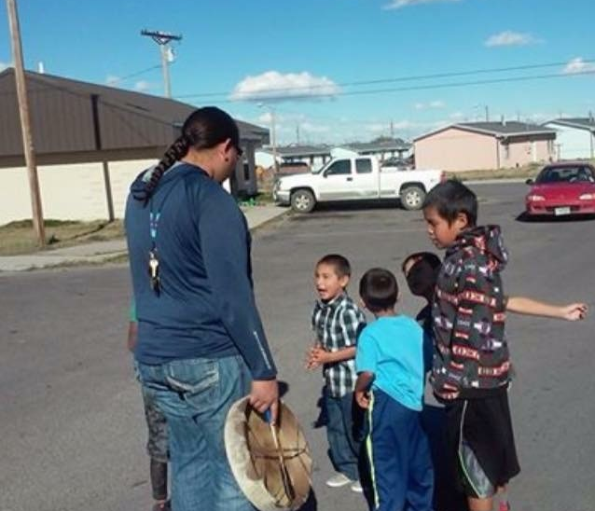
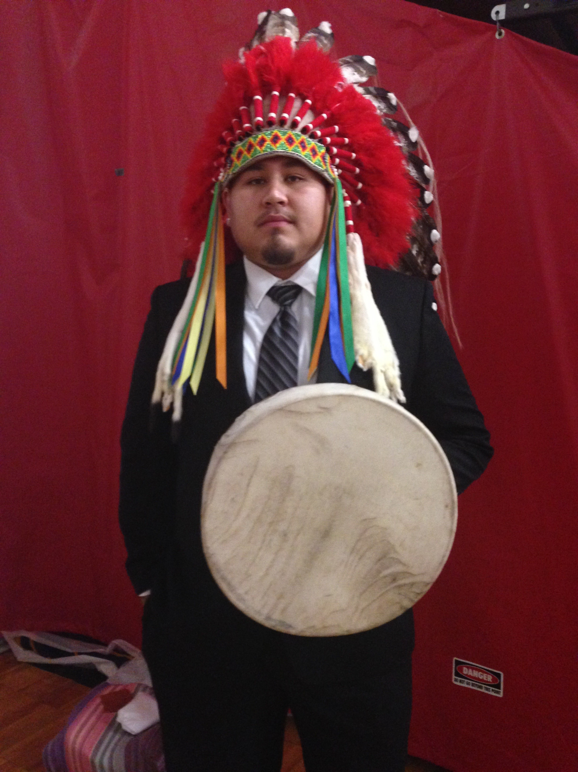
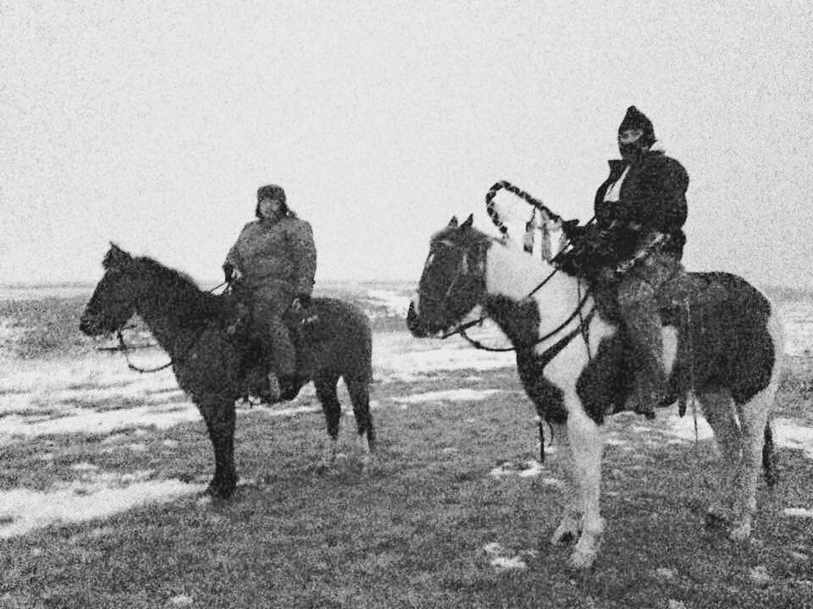
Terrance Lafromboise, MSW-ITR
Mental health consultant (Piikani406consulting)
Gathering of Native Americans (GONA) Master Facilitator
Trauma counselor
Cultural preservationist and ceremonialist
Zero Suicide Grant Manager, Behavioral Health and Developmental Disabilities Division, Montana Department of Public Health and Human Services
MSW, Indigenous Trauma and Resiliency, Factor-Inwentash Faculty of Social Work, University of Toronto
BSW, Summa Cum Laude, School of Social Work, University of Montana

Slide 7
Example of a Training Agenda
Protection/Honor Song
Group Norms
Introductions
Collecting Our Medicine Exercise
Connecting Trauma
Trauma-Informed Leadership
Break/Energizer
Suicide Safer Care: Building Foundations for Assessment, Screening, and Treatment
Reconnecting the Body: Indigenous Mindfulness
Closing/Caring Contacts
Notes:
We are going to start off by creating a safe place. Prayer, Connections and grounding.
And training norms.
Then we are going to start off by talking a little about Trauma, why its important to understand trauma and what that looks like in Indigenous communities.
Then will look at national, Montana and Native American population data because it paints us a picture of the issue of suicide.
We will talk about warning signs, risk factors, protective factors and then tools specific to health care providers. We will finish with identifying crisis resources.
Our goal is to provide tools that can be used immediately following this training.
A point of emphasis is that studies have supported using Suicide Safe Care when the sequence of interventions are used. 1) depression screening, 2) suicide risk assessment, 3) safety planning, 4) lethal means counseling, and 5) follow-up contact. IT’S MORE THAN JUST SCREENING AND ASSESSMENT.

Slide 8
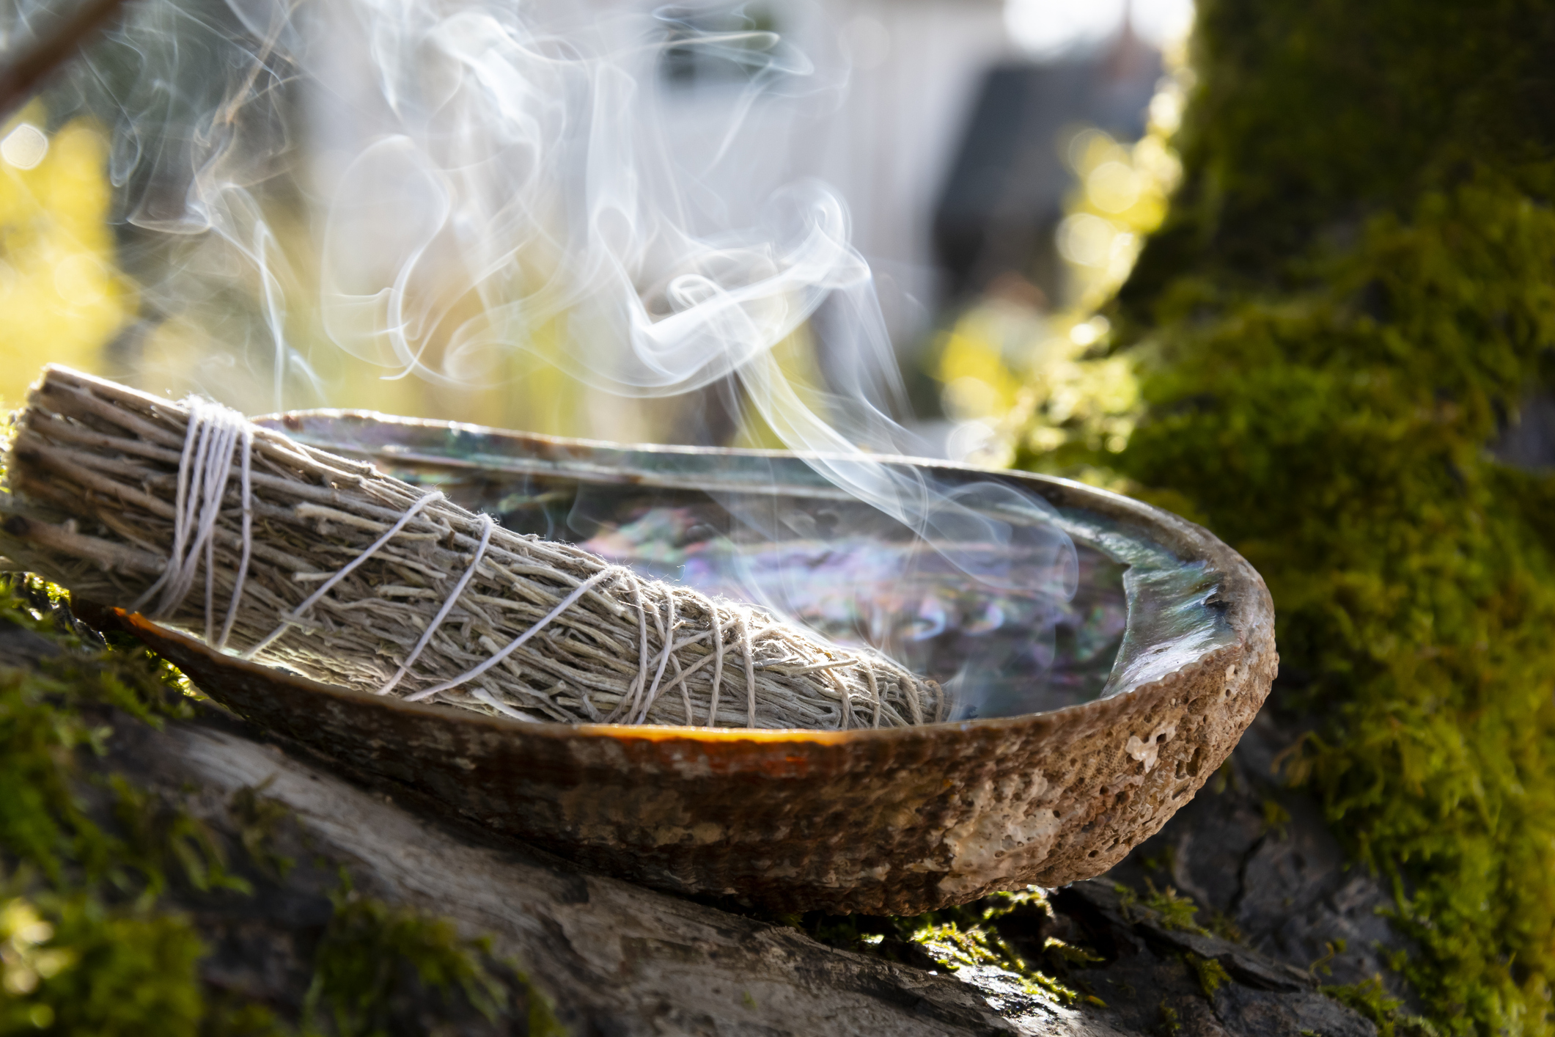
Trauma-Informed Compassionate Healing Process
Teamwork built on empowerment, respect,
safety, honesty, and validation
Teams that value the strengths and abilities of every member

Slide 9
Leadership: Meeting the Needs
Mentoring: Serve as a mentor, not a dictator.
Evaluating: Assess worker wellness, teamwork, ethics, kindness, and needed knowledge.
Empowering: Rather than micro-managing or ignoring staff, encourage growth and creativity while helping to problem-solve challenges.
Training: Provide training and support to ensure team members can confidently succeed in their work.
Notes:
Well trained supervisors, leaders, CEO’s and admins always focus on the goal of meeting the needs of those they serve by providing excellent supervision to those they supervise

Slide 10

Trauma-Informed Leadership
Build bridges, not walls.
Listen rather than lecture.
Show compassion.
Use creativity. Find the strength in each team member and support it.
Ensure wellness through regular debriefings, supervision, and consultation.
Provide an “honest mirror” through kind honesty and honest kindness.
Support teamwork.
Model respect.

Slide 11

Trauma-Informed Leadership (Cont’d)
Create a safe haven.
Support independence.
Developing a partnership for learning “not a testing or contentious learning environment.” Create a space for “Two Way Traffic.”
Provide educational and emotional support.
Use clear and transparent communication.
Demonstrate gifting, role modeling, and mentoring.
Give back and show generosity.

Slide 12
Evidence-Based Practices and Indigenous Knowledge
Practice Indigenous Mindfulness
Engage in psycho-education
Incorporate somatic practices
Spend time in nature
Listen to drums, chants, hymns
Learn local cultural medicines
Hold the medicines (touch, feel, smell)
Close your eyes, ground your feet
Count down
Focus on your breathing
Create a space of safety and awareness
Practice
Reconnect
Heal

Slide 13
Trauma-Informed Care: Being a Good Relative in Indian Country

Slide 14
Dolores Subia BigFoot, PhD
I was raised in a four-generation home, including a great-grandmother who helped me establish my cultural, spiritual, and professional identity. My professional identity seeks balance (mental health) and Seven Directions.
Suicide protective factors include a sense of identity, connectedness, and belonging.
Being raised in a culturally-based family provided the Sacred Circles to give me a sense of identity, connectedness, and belonging.
Being the receiver of Sacred Circles allows me to give the gift of Sacred Circles to my children, grandchildren, and others.

Slide 15

Trauma-Informed Care: Being a Good Relative
Water
Song
Hope
Connectedness
Good words
Prayers
Welcome
Spirit blessing
Choice
Accountability
Confidence
Support
Openness
Acknowledgements
Safety
Reassurance

Slide 16
Trauma-Informed Care: Being a Good Relative
A way to view trauma-informed care is as caring for all others as relatives. Being a good relative means caring for others, actively working to decrease their discomfort, and seeking to eliminate conditions that may harm them. In Indian Country, an understanding of generosity respect, belonging, connectedness, and other virtues is reflected in being a good relative.
Trauma-informed care is a recent term for an approach to providing emotional and physical support and safety in a way that recognizes the impact of trauma and potential trauma triggers. This approach is very different from the experiences of many of our tribal members, who have experienced or witnessed violence and threats in care settings.
Implementing trauma-informed principles comes naturally as we apply a cultural understanding of being a good relative.

Slide 17

Indigenous Knowledge
Great Mystery
Trauma-informed care
Relaxation
Thought stoppage
Breathing
Selective ignoring
Praise
Identity formation
Socialization
Bonding and attachment
Gradual exposure
There are ideas, understandings, information, concepts, techniques, and practices that are marginalized in western knowledge.
These are therapeutic, comforting, reassuring, and healing.

Slide 18
Trauma Informed Care: Transition
Identify the event or experience. What happened?
Provide knowledge, understanding, and safety.
Be aware of behaviors, policies, and surroundings.
Move from what was before to what is now.
Define the experience or trauma rather than the experience or trauma defining the person.
Recognize that memories, reminders, or triggers do not need to devastate us.
Learn healthy self-care skills.
Reveal ourselves to ourselves.
Trauma
Informed
Care
Transition

Slide 19
Resources
Suicide Prevention Resource Center:
www.sprc.org
Substance Abuse and Mental Health Services Administration:
www.samhsa.gov
SAMHSA’s Concept of Trauma and Guidance for a Trauma-Informed Approach: https://store.samhsa.gov/product/SAMHSA-s-Concept-of-Trauma-and-Guidance-for-a-Trauma-Informed-Approach/SMA14-4884
American Indian/Alaska Native Suicide Prevention:
http://sprc.org/settings/aian
American Indian Addendum for the Suicide Prevention Toolkit for Primary Care Practices: SPToolkitAI_Addendum.pdf (wiche.edu)
The National Child Traumatic Stress Network: https://www.nctsn.org/

Slide 20
Collaborating with Tribal Communities:
A Webinar Series
Join us for a six-part webinar series to help crisis centers build collaborative, sustainable relationships with tribal communities.
Designed to support 988 Suicide & Crisis Lifeline staff, this series can also be useful to other practitioners and providers working with people in crisis.
Notes:
Vickie

Slide 21
Collaborating with Tribal Communities:
A Webinar Series
January 24, 2023 - Building Meaningful and Lasting Relationships with Tribal Communities
February 21, 2023 - Cultural Humility
March 21, 2023 - A Trauma-Informed Approach to Working with Tribes
May 23, 2023 - Tribal and Indian Health Service Health Care Systems
July 18, 2023 - Tribal Sovereignty
August 22, 2023 - Know Before You Go! Jurisdictional Considerations

Slide 22
Thank you!
Terrance Lafromboise MSW – ITR
Terrance.Lafromboise@mt.gov
Dolores Subia BigFoot, PhD
Dee-Bigfoot@ouhsc.edu

