Slide 1
Collaborating with Tribal Communities:
A Webinar Series
Webinar 2: Cultural Humility
February 21, 2023
Dolores Subia BigFoot, PhD
Brittany Carradine, MEd
Notes:
Vickie- Welcome

Slide 2
Funding and Disclaimer
The Suicide Prevention Resource Center at the University of Oklahoma Health Sciences Center is supported by a grant from the U.S. Department of Health and Human Services (HHS), Substance Abuse and Mental Health Services Administration (SAMHSA), Center for Mental Health Services (CMHS), under Grant No. 1H79SM083028-01.
The views, opinions, and content expressed in this product do not necessarily reflect the views, opinions, or policies of CMHS, SAMHSA, or HHS.
Notes:
Vickie- pause to acknowledge

Slide 3
About SPRC
The Suicide Prevention Resource Center (SPRC) is the only federally funded resource center devoted to advancing the implementation of the National Strategy for Suicide Prevention. SPRC is supported through a grant from the U.S. Department of Health and Human Services' Substance Abuse and Mental Health Services Administration (SAMHSA).
SPRC builds capacity and infrastructure for effective suicide prevention through consultation, training, and resources for state, tribal, health/behavioral health, and community systems; professionals and professional education programs; and national public and private partners and stakeholders.
Notes:
Vickie- Pause to acknowledge
Vickie- pass to Dee

Slide 4
Land Acknowledgement
We acknowledge that the land that now makes up the United States of America was the traditional home, hunting ground, trade exchange point, and migration route of more than 574 American Indian and Alaska Native federally recognized tribes and many more tribal nations that are not federally recognized or no longer exist.
We recognize the cruel legacy of slavery and colonialism in our nation and acknowledge the people whose labor was exploited for generations to help establish the economy of the United States.
We honor indigenous, enslaved, and immigrant peoples’ resilience, labor, and stewardship of the land and commit to creating a future founded on respect, justice, and inclusion for all people as we work to heal the deepest generational wounds.
Notes:
Dee

Slide 5
Dolores Subia BigFoot
My Background

Slide 6
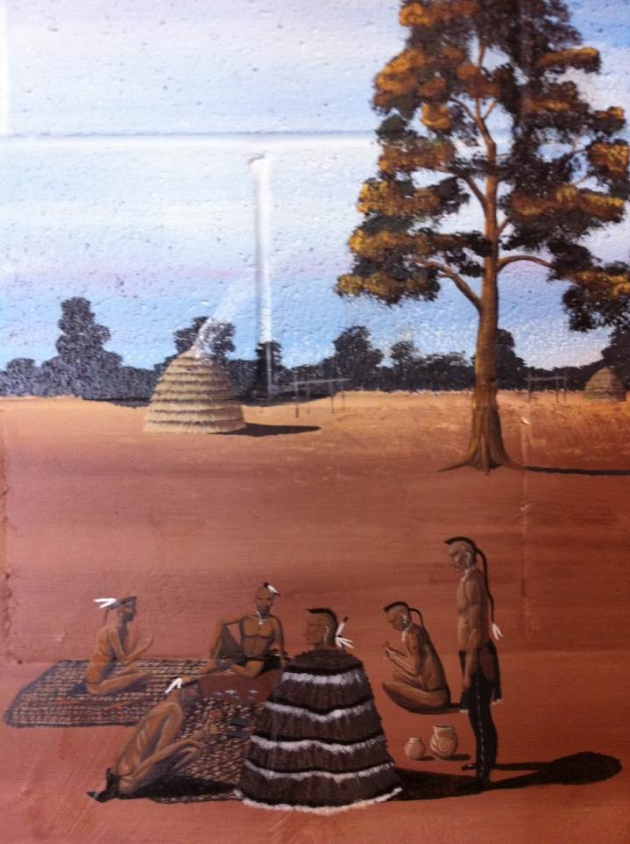
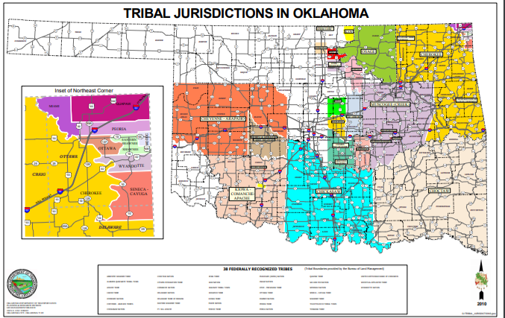
Caddo Nation of Oklahoma
Enrolled tribal member
Daughter
Sister
Mother
Grandmother
Elder
Sacred space in sacred circles

Slide 7
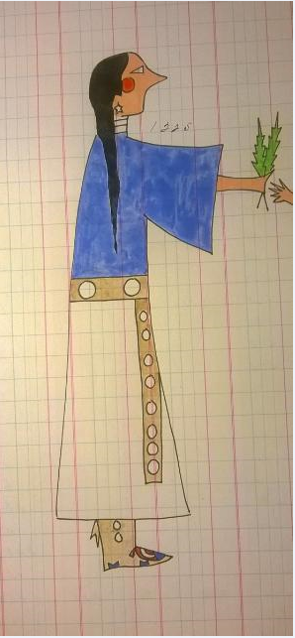
Northern Cheyenne Tribe of Montana
Morning Star Flag of the Northern Cheyenne Tribe
Affiliation with the Northern Cheyenne Tribe of Montana, in which my children are enrolled
Artist: George Levi, Cheyenne

Slide 8
My Background
I was raised in a four-generation home, including a great-grandmother who helped me establish my cultural, spiritual, and professional identity. My professional identity seeks balance (mental health) and Seven Directions.
Suicide protective factors include a sense of identity, connectedness, and belonging.
Being raised in a culturally-based family provided the Sacred Circles to give me a sense of identity, connectedness, and belonging.
Being the receiver of Sacred Circles allows me to give the gift of Sacred Circles to my children, my grandchildren, and others.

Slide 9
Brittany Carradine
My Background
Notes:
Dee pass to Brittany

Slide 10
My Background
I was raised in a community that helped me learn, grow, and establish my cultural, spiritual, and personal identity. My identity seeks wholeness and freedom.
Increased suicide protective factors are a sense of identity, connectedness, and belonging. Being in community with other Black women provides a sense of identity, connectedness, and belonging.

Slide 11
What is JEDI?
Diversity - Range of human differences
Inclusion - Involvement and empowerment, where the inherent worth and dignity of all people are recognized
Equity - Fair and just practices that ensure access, resources, and opportunities are provided for all
Justice - Dismantling barriers to resources and opportunities in society so that all individuals and communities can live a full and dignified life

Slide 12
Cultural Humility
A personal lifelong commitment to self-evaluation and self-critique whereby the individual not only learns about another’s culture but starts with an examination of their own beliefs and cultural identities.
Recognition of power dynamics and imbalances, a desire to fix those power imbalances, and to develop partnerships with people and groups who advocate for others.
Institutional accountability.
Source: Yeager, 2013

Slide 13
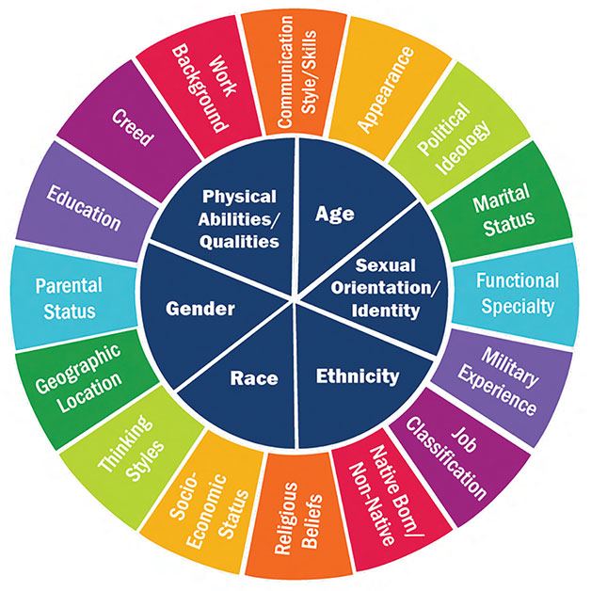
Social Identity Wheel?
Source: Hawkins et al., 2017

Slide 14
Cultural Humility (HUMBLE) Model
H: Humble about the assumptions you make.
U: Understand your own background and culture.
M: Motivate yourself to learn more about the other person's background.
B: Begin to incorporate this knowledge into your work.
L: Lifelong learning.
E: Emphasize respect and negotiate service plans.
Source: Lekas, Pahl, and Fuller, 2020

Slide 15
Emotional Intelligence
 | Emotional Awareness | What we’re feeling and why
 | Emotional Management | Handling distressing emotions effectively without becoming paralyzed
 | Empathy | Understanding and sharing someone else’s feelings
 | Relationship Management | Using emotional quotient to navigate relationships
Notes:
Brittany passes to Dee

Slide 16
Evidence-Based Practices and Indigenous Knowledge
Evidence-Based Practices
Indigenous Knowledge
Cognitive and behavioral principles
Attachment
Humanist
Developmental
Neurobiology
Empowerment
Thinking, feeling, doing
Relational and Circle Theory (Sacred Circles)
We are all related
Naming, Medicine Wheel (Seven Directions)
Mind-body-heart-spirit, we knew the earth was round, racial memories
Non-interference, non-judgment, equity, voice, and empowerment

Slide 17
Indigenous Ways of Knowing
Indigenous Knowledge
Observers of stars, plants, animals, movement, ice, water, wind, earth
Understandings of who we are, where we came from, and where we are going
Wisdom
Reflections
Beliefs
Practices
Relational
Kinships
Awareness
Great Mystery
Understandings, self-revelations, and knowledge
that cannot be explained with science or hard evidence

Slide 18
Culturally Based Self-Assessment
Those who walk in front
Those who walk in back
Those who walk side by side
Upward
Downward
Inward
Seven Directions
Notes:
Dee: explain the 7 since there are six bullets.

Slide 19
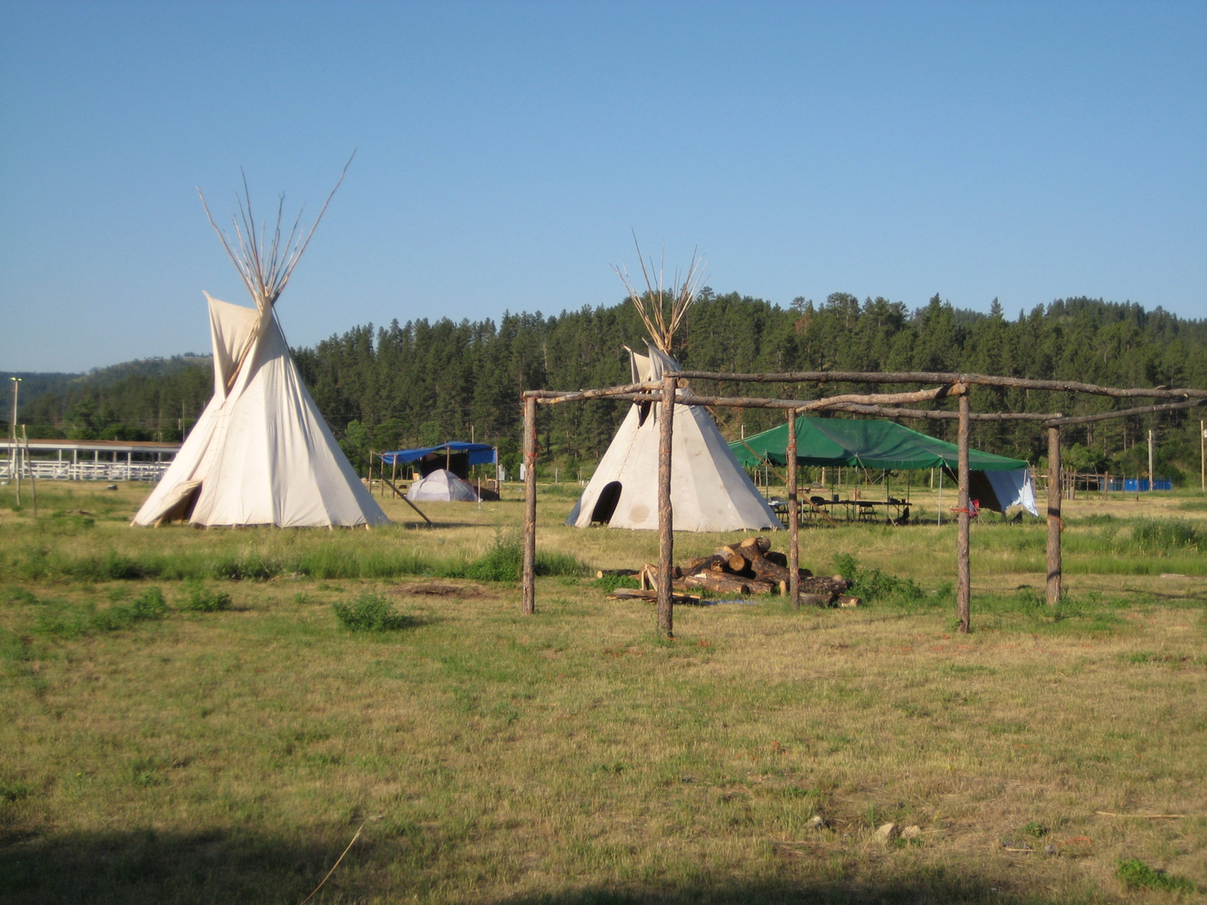
Questions?

Slide 20
Resources
Suicide Prevention Resource Center: www.sprc.org
Substance Abuse and Mental Health Services Administration: www.samhsa.gov
National Action Alliance for Suicide Prevention: www.actionallianceforsuicideprevention.org
American Indian/Alaska Native Suicide Prevention: http://www.sprc.org/populations/aian
Suicide Prevention with American Indians and Alaska Natives in Indian Country: https://www.youtube.com/watch?v=5Bd4FP-BnAk

Slide 21
References
Hawkins, B. W., Morris, M., Nguyen, T., Siegel, J., & Vardell, E. (2017). Advancing the conversation: Next steps for lesbian, gay, bisexual, trans, and queer (LGBTQ) health sciences librarianship. Journal of the Medical Library Association, 105(4), 316–327. https://doi.org/10.5195/jmla.2017.206.
Lekas, H. M., Pahl, K., & Fuller Lewis, C. (2020). Rethinking cultural competence: Shifting to cultural humility. Health Services Insights, 13, 1178632920970580. https://doi.org/10.1177/1178632920970580.
Yeager, K.A., & Bauer-Wu, S. (2013). Cultural humility: Essential foundation for clinical researchers. Applied Nursing Research, 26(4): 251-256. https://doi.org/10.1016/j.apnr.2013.06.008.

Slide 22
Collaborating with Tribal Communities: A Webinar Series
Join us for a six-part webinar series to help crisis centers build collaborative, sustainable relationships with tribal communities.
Designed to support 988 Suicide & Crisis Lifeline staff, this series can also be useful to other practitioners and providers working with people in crisis.
Notes:
Vickie

Slide 23
Collaborating with Tribal Communities: A Webinar Series
January 24, 2023 - Building Meaningful and Lasting Relationships with Tribal Communities
February 21, 2023 - Cultural Humility
March 21, 2023 - A Trauma-Informed Approach to Working with Tribes
May 23, 2023 - Tribal and Indian Health Service Health Care Systems
July 18, 2023 - Tribal Sovereignty
August 22, 2023 - Know Before You Go! Jurisdictional Considerations

Slide 24
Thank you!
Dolores Subia BigFoot, PhD
Dee-Bigfoot@ouhsc.edu
Brittany Carradine, MEd
Brittany-Carradine@ouhsc.edu

