Slide 1
Collaborating with Tribal Communities: A Webinar Series
Webinar 4: Tribal and Indian Health Service Health Care Systems
May 23, 2023
Pamela End of Horn, DSW, LICSW, Oglala Lakota
Glenna P. Stumblingbear-Riddle, PhD, Kiowa (Khoiye-hayn-ee) Anitra Warrior, PhD, Ponca Tribe

Slide 2


Funding and Disclaimer
The Suicide Prevention Resource Center at the University of Oklahoma Health Sciences Center is supported by a grant from the U.S. Department of Health and Human Services (HHS), Substance Abuse and Mental Health Services Administration (SAMHSA), Center for Mental Health Services (CMHS), under Grant No. 1H79SM083028-01.
The views, opinions, and content expressed in this product do not necessarily reflect the views, opinions, or policies of CMHS, SAMHSA, or HHS.

Slide 3
About SPRC
The Suicide Prevention Resource Center (SPRC) is the only federally funded resource center devoted to advancing the implementation of the National Strategy for Suicide Prevention. SPRC is supported through a grant from the U.S. Department of Health and Human Services' Substance Abuse and Mental Health Services Administration (SAMHSA).
SPRC builds capacity and infrastructure for effective suicide prevention through consultation, training, and resources for state, tribal, health/behavioral health, and community systems; professionals and professional education programs; and national public and private partners.

Slide 4
Land Acknowledgement
We acknowledge that the land that now makes up the United States of America was the traditional home, hunting ground, trade exchange point, and migration route of more than 574 American Indian and Alaska Native federally recognized tribes and many more tribal nations that are not federally recognized or no longer exist.
We recognize the cruel legacy of slavery and colonialism in our nation and acknowledge
the people whose labor was exploited for generations to help establish the economy of the United States.
We honor indigenous, enslaved, and immigrant peoples’ resilience, labor, and stewardship
of the land and commit to creating a future founded on respect, justice, and inclusion for all people as we work to heal the deepest generational wounds.

Slide 5

Discussion

Slide 6
Collaborating with Tribal Communities:
A Webinar Series
Join us for a six-part webinar series to help crisis centers build collaborative, sustainable relationships with tribal communities.
Designed to support 988 Suicide & Crisis Lifeline staff, this series can also be useful to other practitioners and providers working with people in crisis.
Notes:
Vickie

Slide 7
Collaborating with Tribal Communities:
A Webinar Series
January 24, 2023 - Building Meaningful and Lasting Relationships with Tribal Communities
February 21, 2023 - Cultural Humility
March 21, 2023 - A Trauma-Informed Approach to Working with Tribes
May 23, 2023 - Tribal and Indian Health Service Health Care Systems
July 18, 2023 - Tribal Sovereignty
August 22, 2023 - Know Before You Go! Jurisdictional Considerations

Slide 8
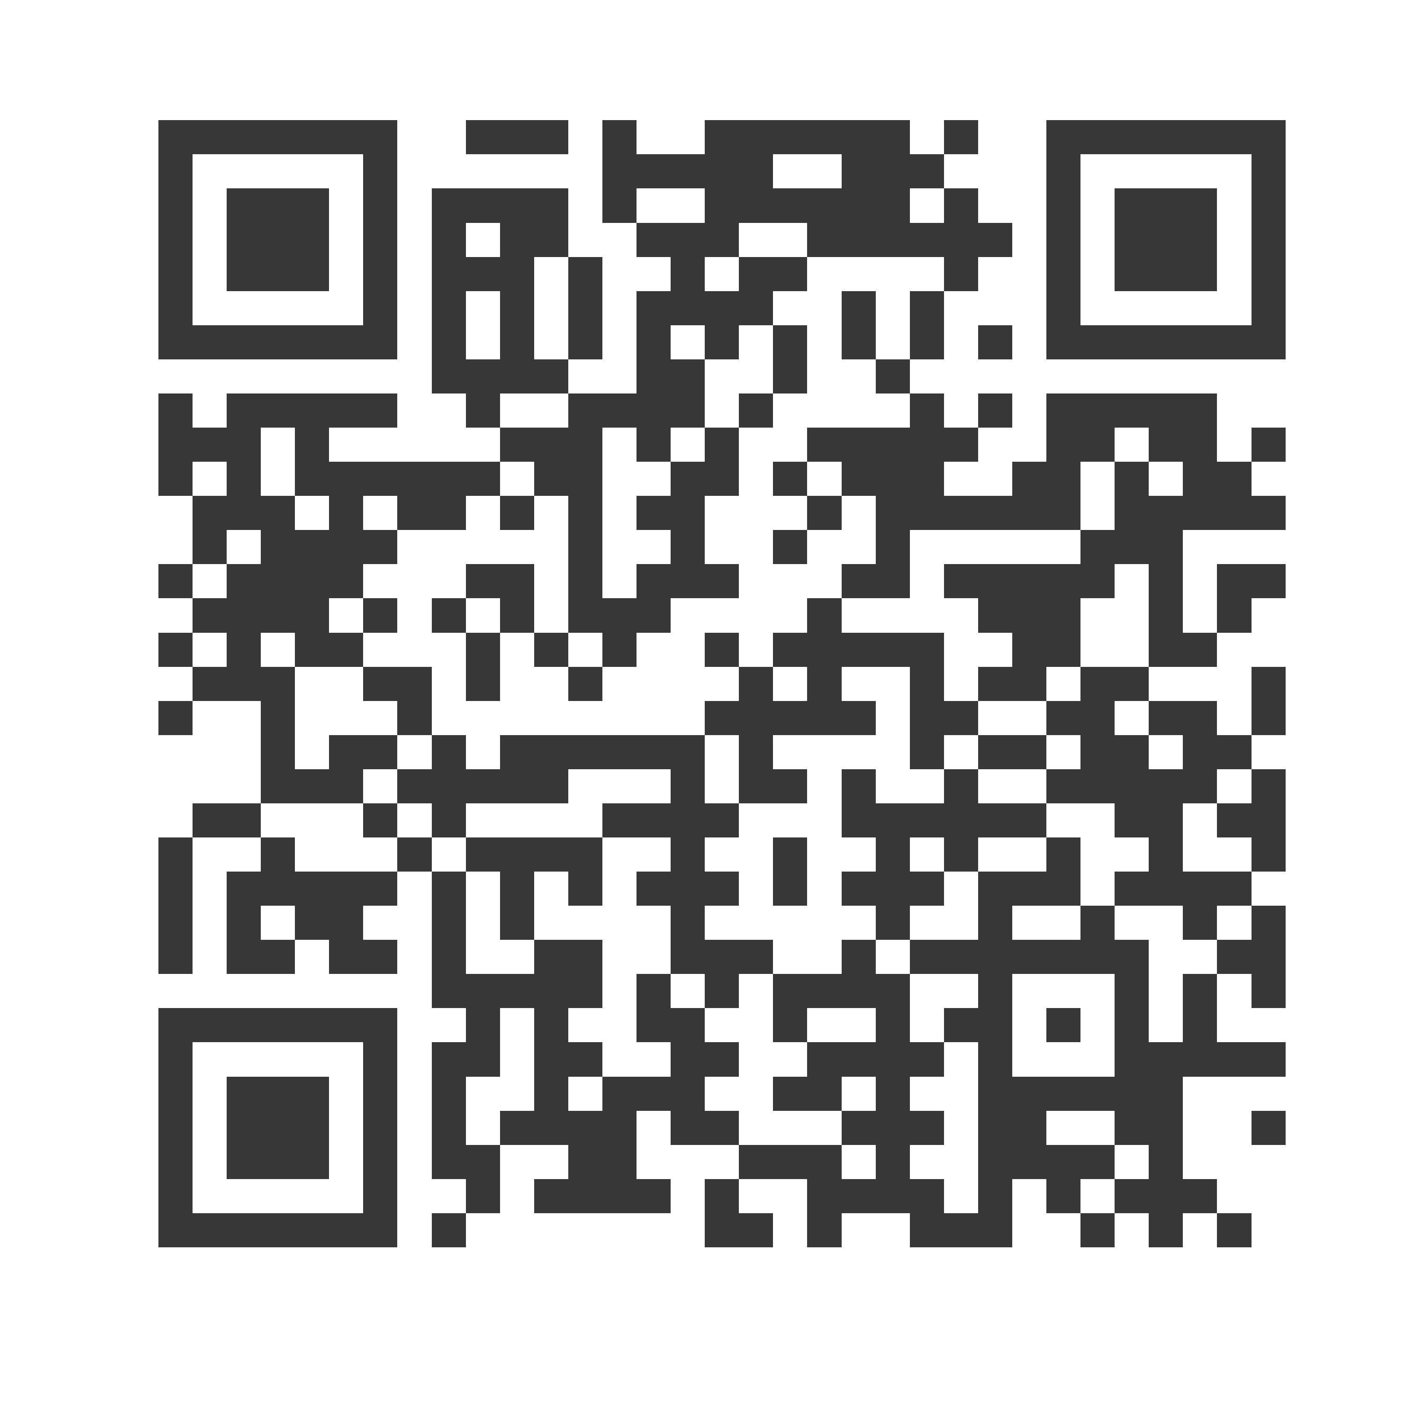
Thank you!
Glenna P. Stumblingbear-Riddle, PhD (Khoiye-hayn-ee)
gpsr.phd@rtribalroots.com
Pamela End of Horn, DSW, LICSW (Oglala Lakota)
pamela.endofhorn@ihs.gov
Anitra Warrior, PhD
dr.warrior@morningstar-counseling.com
Subscribe to the Weekly Spark
Sign up to receive the latest news, research, and announcements from SPRC delivered to your inbox.

