Slide 1
Collaborating with Tribal Communities: A Webinar Series
Webinar 5: Tribal Sovereignty
July 18, 2023
Nathan Billy, MEd, LPC (Choctaw Nation of Oklahoma) Director of Behavioral Health Programs
National Indian Health Board, Washington, D.C.

Slide 2
Funding and Disclaimer
The Suicide Prevention Resource Center at the University of Oklahoma Health Sciences Center is supported by a grant from the U.S. Department of Health and Human Services (HHS), Substance Abuse and Mental Health Services Administration (SAMHSA), Center for Mental Health Services (CMHS), under Grant No. 1H79SM083028.
The views, opinions, and content expressed in this product do not necessarily reflect the views, opinions, or policies of CMHS, SAMHSA, or HHS.

Slide 3
About SPRC
The Suicide Prevention Resource Center (SPRC) is the only federally funded resource center devoted to advancing the implementation of the National Strategy for Suicide Prevention. SPRC is supported through a grant from the U.S. Department of Health and Human Services' Substance Abuse and Mental Health Services Administration (SAMHSA).
SPRC builds capacity and infrastructure for effective suicide prevention through consultation, training, and resources for state, tribal, health/behavioral health, and community systems; professionals and professional education programs; and national public and private partners.

Slide 4
Land Acknowledgement
We acknowledge that the land that now makes up the United States of America was the traditional home, hunting ground, trade exchange point, and migration route of more than 574 American Indian and Alaska Native federally recognized tribes and many more tribal nations that are not federally recognized or no longer exist.
We recognize the cruel legacy of slavery and colonialism in our nation and acknowledge the people whose labor was exploited for generations to help establish the economy of the United States.
We honor indigenous, enslaved, and immigrant peoples’ resilience, labor, and stewardship of the land and commit to creating a future founded on respect, justice, and inclusion for all people as we work to heal the deepest generational wounds.

Slide 5
Overview
Colonization, historical trauma, and the establishment of Tribal sovereignty
Implications of Tribal sovereignty
Honoring Tribal sovereignty in practice

Slide 6
Colonization
Threats to Tribal Sovereignty
The Doctrine of Discovery
Manifest Destiny
Genocide, Westward Expansion, and the origins of treaties
Notes:
Tip: To replace this photo, click on photo box and right-click. Select “change picture.”
Note: Bullets should be used instead of numbered lists except in very specific circumstances (e.g., when referring to the top three findings in a survey, the steps in a four-part sequential process, etc.) If used, the numerals in numbered lists should be in black font color. To change numerals in numbered lists from yellow to black, go to Bullets and Numbering options, select the number format and change the color to black.

Slide 7
Historical Trauma and Aftermath
Cultural Genocide and Assimilation
Federal Indian boarding school policy
The “civilizing” of Tribes
Tribal sovereignty established

Slide 8
Implications of Tribal Sovereignty
What Tribal Sovereignty Means
A government-to-government relationship
The trust responsibility
Health care is not “filtered” through states
An ongoing responsibility to support self-governance
Image: https://www.domesticpolicycaucus.com/tribal-sovereignty

Slide 9
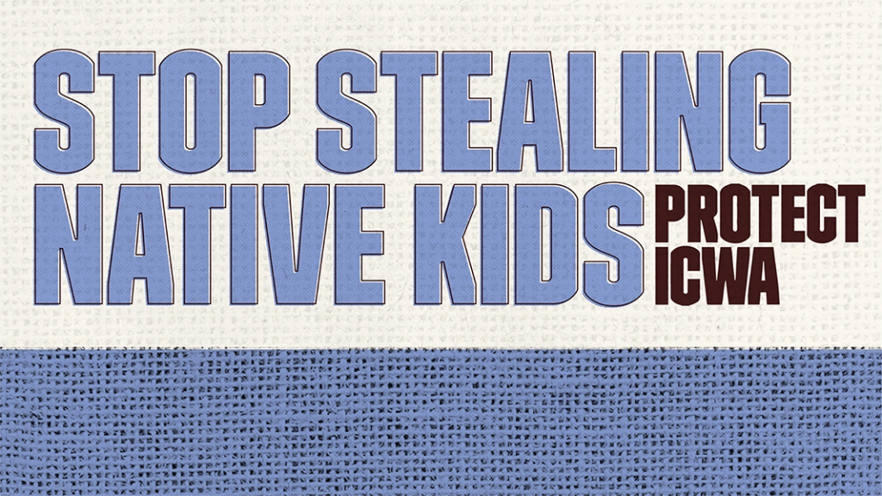
Tribal Sovereignty and Health Care
Important Acts in Tribal Health
Indian Health Care Improvement Act (IHCIA)
Indian Self-Determination and Education Assistance Act (ISDEAA)
The Indian Health Service (IHS)
The Indian Child Welfare Act (ICWA)

Slide 10
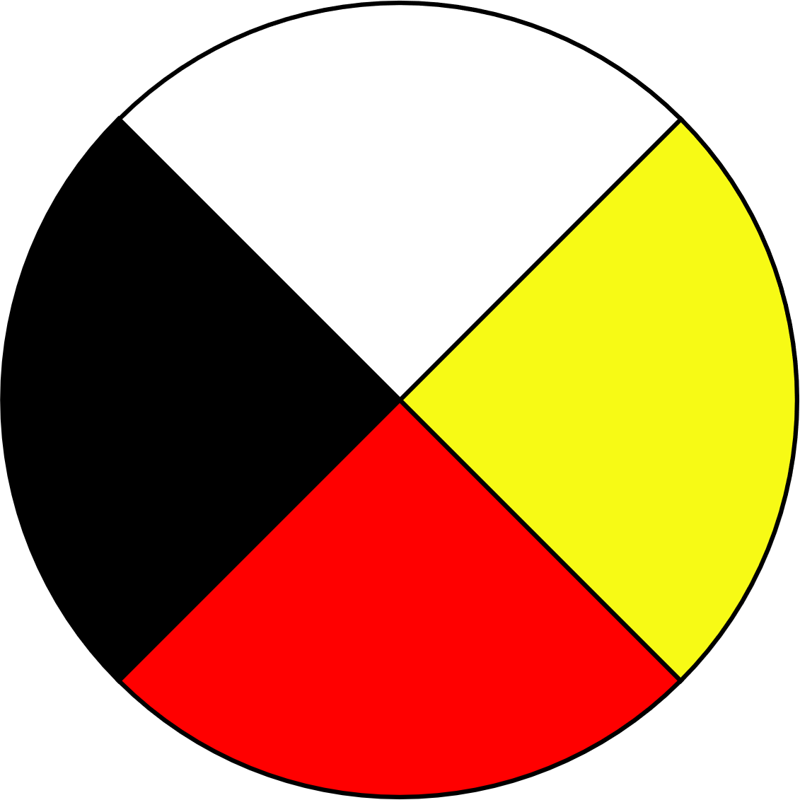
Honoring Tribal Sovereignty In Practice
Some Potential Roadblocks
Controlling space that should be Tribally driven
Well-intentioned help: Paternalism, the “savior complex”
Filtering health care through states and non-Tribal entities
Elevating Western, “evidenced-based practice” and deeming Tribal practices “alternative” or “other”

Slide 11
Collaboration with Tribal Nations
Priorities
Honor Tribes as sovereign nations in practices
Ensure Tribes are equal partners in all processes and stages
Pursue cultural humility, and only secondarily, cultural competence
Focus on Tribal strengths and provide space to celebrate Tribes
What is good? What is powerful? What is protective?
Do not be afraid to ask: “What can I do? How can I best walk alongside you?”

Slide 12
Collaborating with Tribal Communities: A Webinar Series
January 24, 2023 - Building Meaningful and Lasting Relationships with Tribal Communities
February 21, 2023 - Cultural Humility
March 21, 2023 - A Trauma-Informed Approach to Working with Tribes
May 23, 2023 - Tribal and Indian Health Service Health Care Systems
July 18, 2023 - Tribal Sovereignty
August 22, 2023 - Know Before You Go! Jurisdictional Considerations

Slide 13
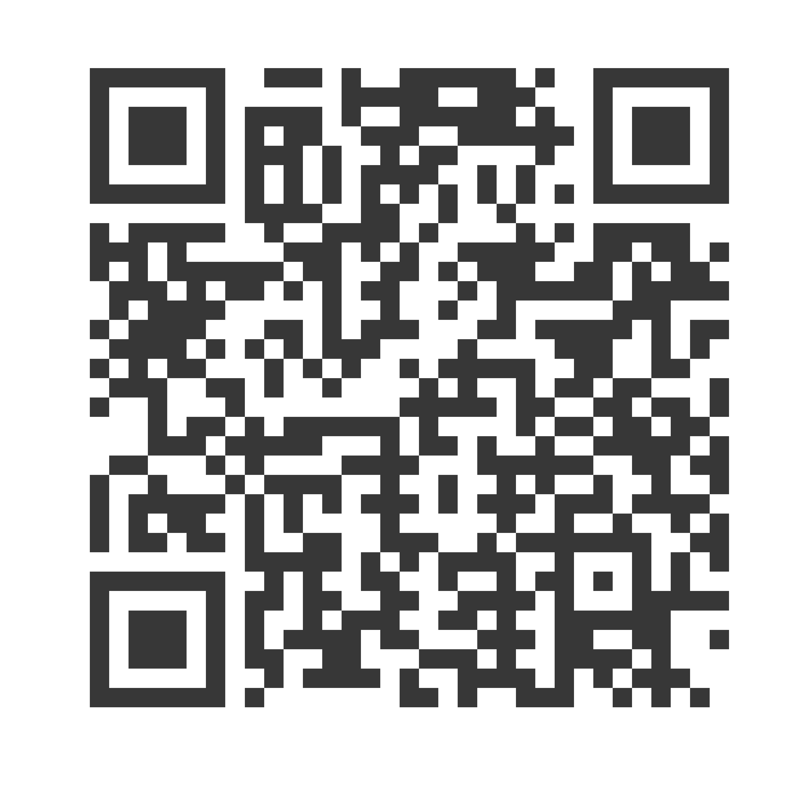
Yakoke! Thank you!
Nathan Billy
National Indian Health Board
nbilly@nihb.org
Subscribe to the Weekly Spark
Sign up to receive the latest news, research, and announcements from SPRC delivered to your inbox.

