Slide 1
Collaborating With Tribal Communities: A Webinar Series
Webinar 6: Know Before You Go! Jurisdictional Considerations
October 24, 2023
Pamela End of Horn, DSW, LICSW (Oglala Lakota)
Rochelle Hamilton, MS (Ehattesaht First Nation, British Columbia, Canada)
Geri Wisner, JD (Muscogee (Creek) Nation)

Slide 2


Funding and Disclaimer
The Suicide Prevention Resource Center at the University of Oklahoma Health Sciences Center is supported by a grant from the U.S. Department of Health and Human Services (HHS), Substance Abuse and Mental Health Services Administration (SAMHSA), Center for Mental Health Services (CMHS), under Grant No. 1H79SM083028.
The views, opinions, and content expressed in this product do not necessarily reflect the views, opinions, or policies of CMHS, SAMHSA, or HHS.

Slide 3
About SPRC
The Suicide Prevention Resource Center (SPRC) is the only federally funded resource center devoted to advancing the implementation of the National Strategy for Suicide Prevention. SPRC is supported through a grant from the U.S. Department of Health and Human Services' Substance Abuse and Mental Health Services Administration (SAMHSA).
SPRC builds capacity and infrastructure for effective suicide prevention through consultation, training, and resources for state, tribal, health/behavioral health, and community systems; professionals and professional education programs; and national public and private partners.

Slide 4
Land Acknowledgement
We acknowledge that the land that now makes up the United States of America was the traditional home, hunting ground, trade exchange point, and migration route of more than 574 American Indian and Alaska Native federally recognized tribes and many more tribal nations that are not federally recognized or no longer exist.
We recognize the cruel legacy of slavery and colonialism in our nation and acknowledge
the people whose labor was exploited for generations to help establish the economy of the United States.
We honor indigenous, enslaved, and immigrant peoples’ resilience, labor, and stewardship
of the land and commit to creating a future founded on respect, justice, and inclusion for all people as we work to heal the deepest generational wounds.

Slide 5

Discussion

Slide 6
Collaborating with Tribal Communities:
A Webinar Series
This six-part webinar series was created to help crisis centers build collaborative, sustainable relationships with tribal communities.
Designed to support 988 Suicide & Crisis Lifeline staff, this series can also be useful to other practitioners and providers working with people in crisis.
Notes:
Vickie

Slide 7
Collaborating with Tribal Communities:
A Webinar Series
January 24, 2023 - Building Meaningful and Lasting Relationships with Tribal Communities
February 21, 2023 - Cultural Humility
March 21, 2023 - A Trauma-Informed Approach to Working with Tribes
May 23, 2023 - Tribal and Indian Health Service Health Care Systems
July 18, 2023 - Tribal Sovereignty
October 24, 2023 - Know Before You Go! Jurisdictional Considerations
SPRC 2023 Tribal Webinars - YouTube
2024 Webinars
Titles and Dates: Coming Soon!

Slide 8


Coming Early November: 988 Formative Research
Findings:
Insights about the attitudes, beliefs, perceptions, barriers, and motivations related to help-seeking behaviors and 988
Evidence-based message frames to motivate use of 988
Included Populations:
American Indian/Alaska Native youth and young adults (ages 13-34)
Asian American, Native Hawaiian, and Pacific Islander (AANHPI) youth and young adults (ages 13-34)
Black youth and young adults (ages 13-34)
Hispanic youth and young adults (ages 13-34)
Individuals who have attempted suicide or experienced serious thoughts of suicide during their lifetime (ages 13+)
LGBTQIA+ youth and adults (ages 13-49)
People with disabilities (ages 13+)
Rural older men (ages 49+)
Notes:
In early November, findings from a collaborative research study between the Action Alliance, SPRC, the Ad Council Research Institute, and SAMHSA will become available.
The 988 Formative Research will include a report that describes the attitudes, beliefs, perceptions, barriers, and motivations of eight populations at higher risk for or disproportionately impacted by suicide (at right). In addition, the study generated evidence-based message frames to encourage use of 988.
The project is publishing a full report as well as a communications toolkit to help anyone communicating about 988 use these insights in their communications planning, development, and testing.
Be on the lookout for more information about how to access the findings online in early November.

Slide 9

Questions?

Slide 10
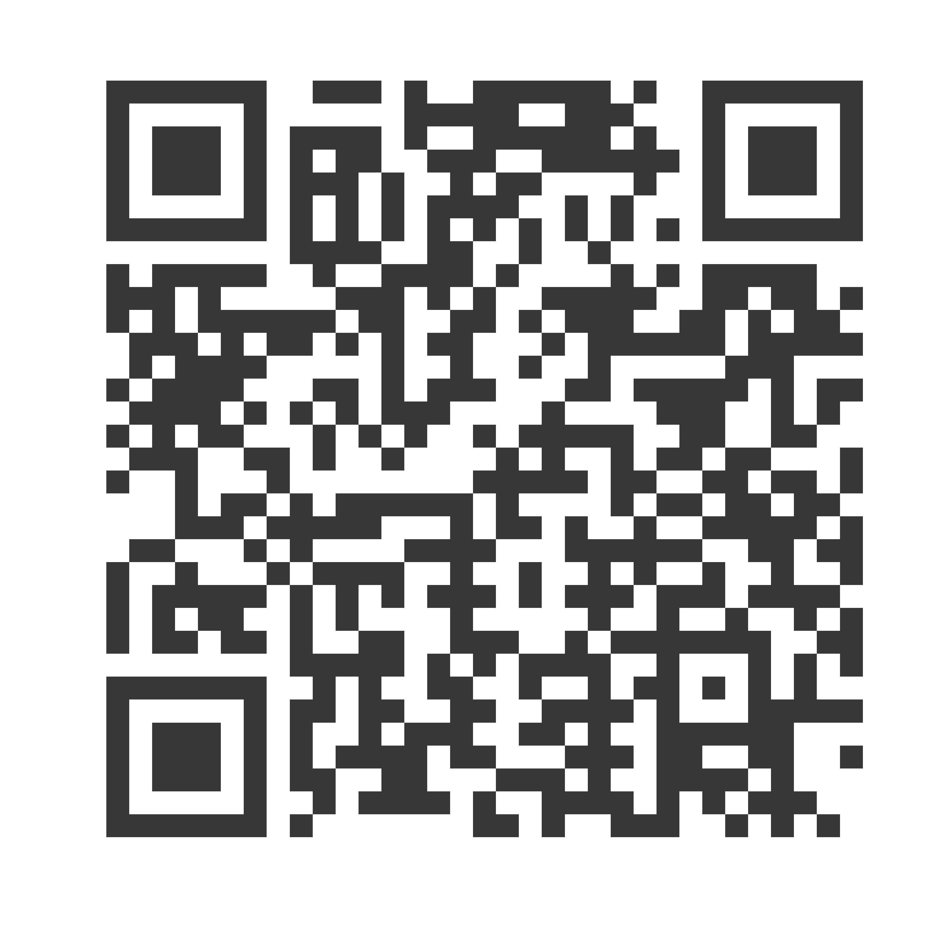
Thank you!
Pamela End of Horn, DSW, LICSW (Oglala Lakota)
pamela.endofhorn@ihs.gov
Rochelle Hamilton, MS (Ehattesaht First Nation, British Columbia, Canada)
rwilliams@voaww.org
Geri Wisner, JD (Muscogee (Creek) Nation)
gwisner@mcnag.com
Subscribe to the Weekly Spark
Sign up to receive the latest news, research, and announcements from SPRC delivered to your inbox.

